Slide 1
Bird
Samir Hauser, Connor Charlton, Joel Alder

Slide 2

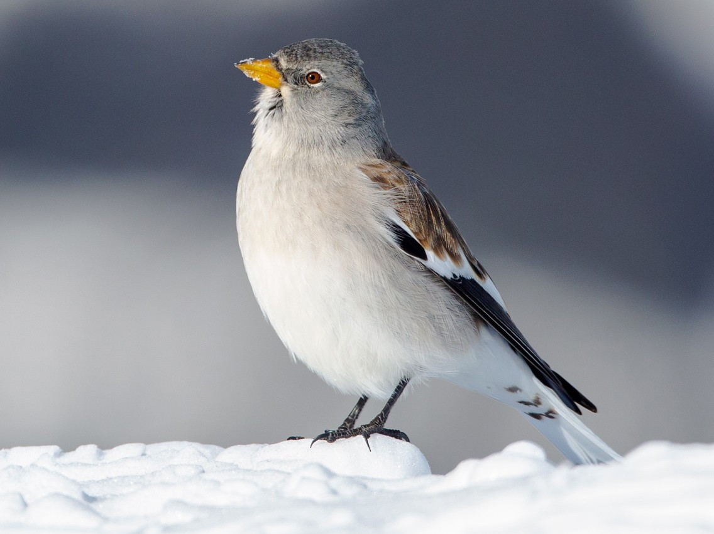
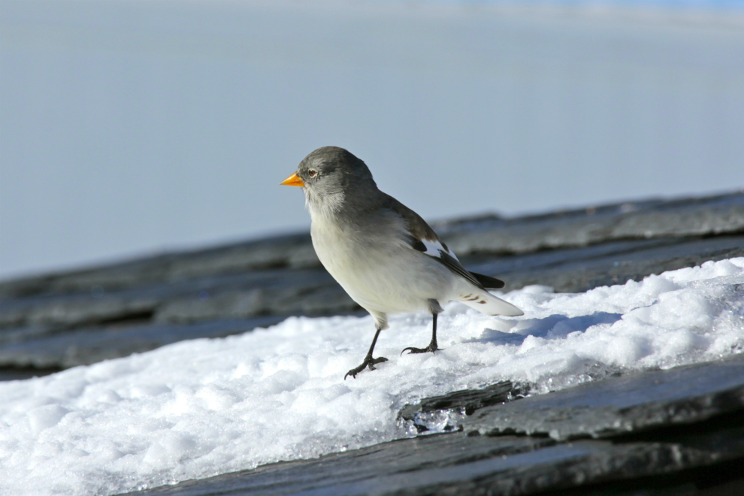
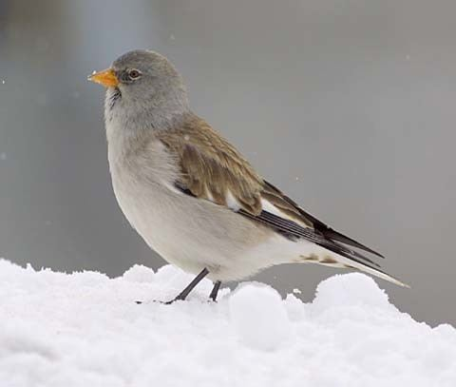
Snow-finches

Slide 3
Background
Survival chance of snow-finches depend on sex
Visually not possible to determine the sex
Chapture the birds and measure metomorpholigcal treats (weight, feather length, etc.)
Researcher determine the sex via a gene test
Main Goal: Possibility to determine the sex via the metomorpholigcal treats

Slide 4
Research Question
Develop a model that gives the probability for the sex via the methomorphical traits
Identify which measurements are important, that they know which one possibily to drop
Develop a model for the adult birds first and then incooparte nestlings data

Slide 5
Data
Data format: CSV
Total observations: 2287 (706 nestling)
Many NAs (difficult to measure)
Variable | Description
Age | 1 = nestling , >1 : adult bird
Wing | length in mm
P1 / P8 | feather length
Tarsus | leg length
Weight | in g (strongly varies with time of year)
Fat | (0 = lean, 6 = fat)
Muscle | (0 = hardly any muscle, 3 = a lot of muscle)
Bill length | mm
Sex_genetic | response

Slide 6
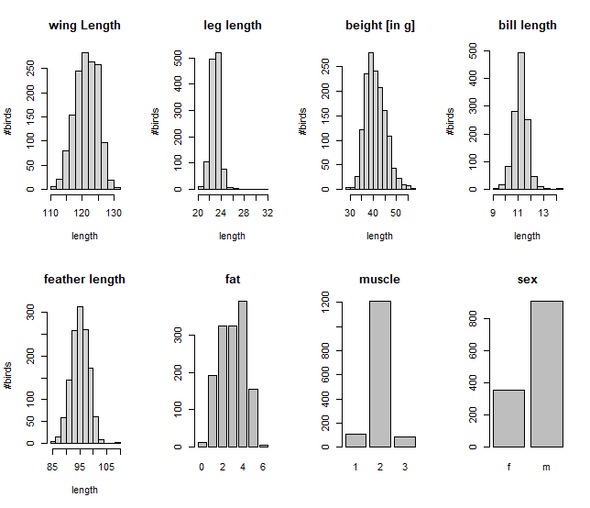
Adult bird data
Variable | NaN | % of total
Wing | 135 | 6.5%
Tarsus | 349 | 22.4%
Bill length | 375 | 24.0%
feather length | 267 | 17.1%
weight | 92 | 5.9%
Fat | 160 | 10.3%
Muscle | 158 | 10.12%
sex_genetics | 298 | 19.1%

Slide 7
Approach
Missing Data
Regression to fill up the missing values
Supervised learning method to determine Sex
Seperate models for adult and nestlings
Classification
Logistic Regression
Trees & Random Forest

